Slide 1
8D Report
for cosmetic issue of BFX - AT100 (T99X171)
Date : 2 July 2020
Prepared by: Heng Ruan
1

Slide 2
D1. Establish the Team
Team Leader: David Yin
QA: Deng Wei Gen
PQE: Heng Ruan
PM: Ben Trinh/ Nelly Ruan
PD: Wen Yong
PE: Mark Wu/Vu Hue
IE: Thu Hang/Van Quyen
SQE: Ken Pham/Xuan Khoa
1

Slide 3
D2. Description of the Problem
Issue Description
2 Jul 2020, ALT customer complain [BFX-AT100] 1st Mass production Cosmetic issue.
Defect Total
RCU missing : 7/500pcs : Defect rate : 1.2%
Inner sheet missing on carton box: 1/500pcs : Defect rate: 0.2%
Giftbox FOD (look like scratch) : 1/500pcs : Defect rate: 0.2%
Label Font change: All units
Giftbox contamination: 2/500pcs: Defect rate: 0.4%
1

Slide 4
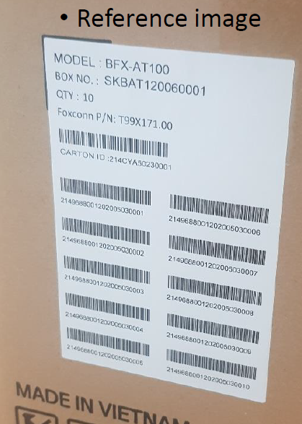
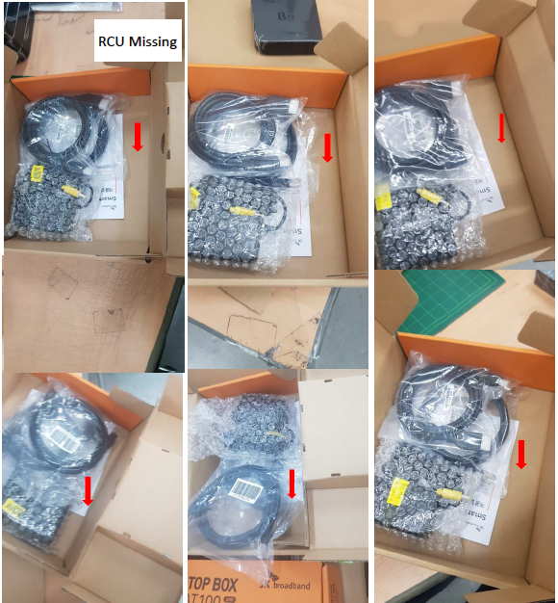
D2. Description of the Problem (continue)
2.1. RCU missing
Defect q’ty: 7/500pcs
Defect rate: 1.2%
RCU was missing on giftbox –1carton (SN : SKBAT2006001).
1. 2149688001202005030001
2. 2149688001202005030002
3. 2149688001202005030003
4. 2149688001202005030010
5. 2149688001202005030009
6. 2149688001202005030008
7. 2149688001202005030007
1

Slide 5
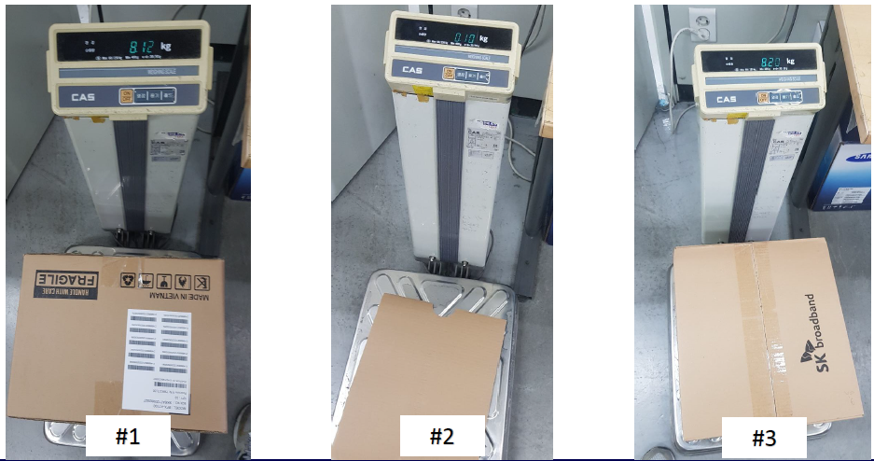
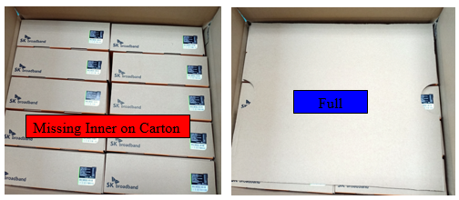
D2. Description of the Problem (continue)
2.2. Inner sheet missing on carton box
Defect q’ty: 1/500pcs
Defect rate: 0.2%
Reference
1. Defected carton weight : 8.12Kg
2. 1 pcs Inner sheet weight : 0.1kg
3. Normal carton weight : 8.2Kg~8.22kg
1

Slide 6
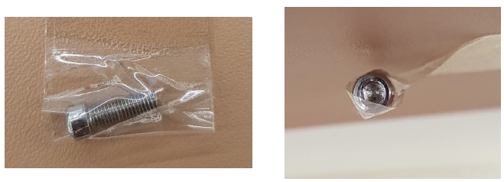
D2. Description of the Problem (continue)
2.3. Giftbox FOD (look like scratch)
Defect q’ty: 1/500pcs (0.2%)
Undefined screw was packed gift packing. Please refer to the below image
SN : N/A
1

Slide 7
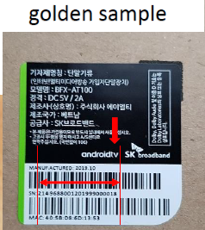
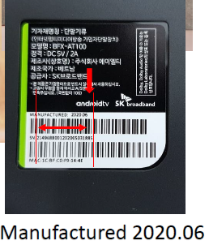
D2. Description of the Problem (continue)
2.4. Label Font change: All units (cont):
Defect q’ty: 500/500pcs
Defect rate: 100%
ALT Comment
• All of changes need to be approved by customer.
• The label font and space between letters changes is also need to approved by customer.
• Look like the letters is difficult to read due to the small text.
• We had already received VoC that hard to read text from SKB installer by visually.
1

Slide 8
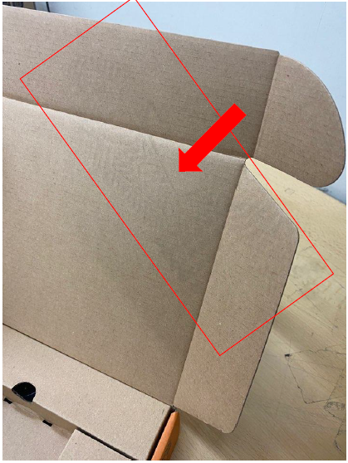
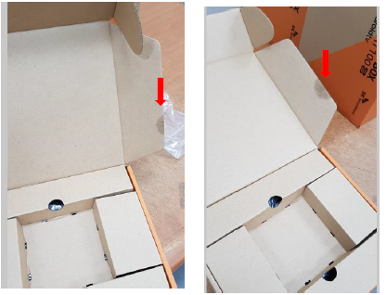
D2. Description of the Problem (continue)
2.5. Giftbox contamination
Defect q’ty: 2/500pcs
Defect rate: 0.4%
SN : 2149688001202005031884
SN : N/A
There is looks like a oil contamination.
There is looks like a shoe footprint.
1

Slide 9
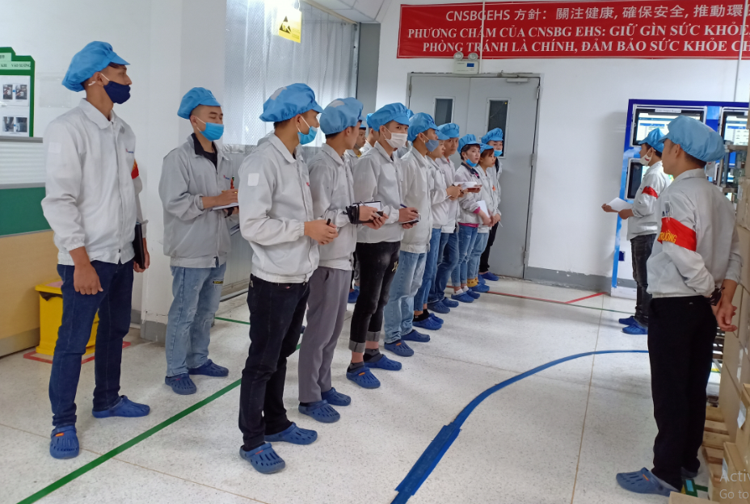

D3. Containment
Immediately notice this issue to all line leader & operators at production line and hang quality alert to all related working stations (VI station, Packing, OBA station) on 7/02 when we get customer feedback issue.
Owner: PQE/PD/PE/IE/SQE: Heng Ruan, Wen Yong, Vu Hue,Van Quyen, Xuan Khoa
Done : 2 Jul 2020
1

Slide 10
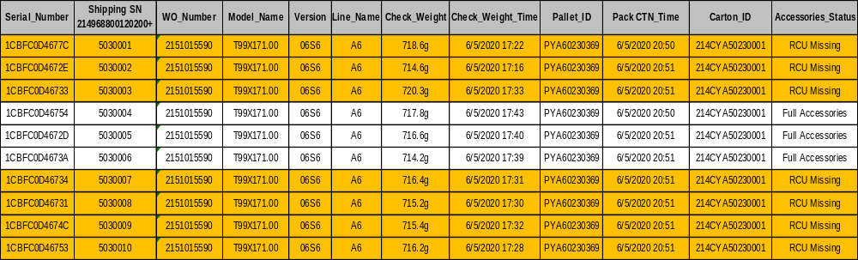
D4. Identify the Root Cause
4.1. For RCU missing:
4.1.1. Check System SFC data: find out 7 pcs missing RCU inside 1 Carton No: SKBAT2006001 ( Foxconn Carton No: 214CYA50230001 ) This Carton have 10 pcs SN from 2149688001202005030001 to 2149688001202005030010
4.1.2. Check production line record: find out this is the First Carton No of T99X171.00 ( BFX-AT100 ). Belong to first Control run Work order, Purpose Run new line and new process in B06 factory of BFX-AT100. ( 05-June-2020 )
1

Slide 11
D4. Identify the Root Cause
4.1.3. Check Production Process:
VI 1
Keypart
Pack_Box
Check Weigt
PACK_CTN
PACK-PLT
OBA
Follow production process, have 3 risk stations remark in red color make:
Station | Cause type | Root cause
Keypart | Occur Cause | This model’s RCU no have material control barcode so no scan key_part station to link RCU with Device, other accessory have barcode scan normal for control right and enough accessory material. Start control run work order at 6/05 dayshift, RCU is shortage and was arrive factory at 6/05 mid night
Check Weight | Occur Cause | Normal at check weight station need 10 sample full box for set up check weight station for the first time run line On 5-Jun, RCU material not arrive factory, we got only 3 RCU inventory, For setup line the first MO run new model Line leader used 3 RCU to set up check weight station for Scan Pass Check_Weigh (Put RCU in then take them out). SFC data at check weight station is pass normal and 10 sample going next station CTN. But actually that time 7 RCU material not available on box. Ps. Normally the check weight can filter out gift boxes not meeting the standard weight value as shown in next slide appendix.
Pack_CTN | Escape Cause | Normal OP scan 10 pcs the first sample for printer out first carton label for FAI. All product going to Pack_PLT station After printer carton Label – 18:15 PM , this carton must be remark missing accessory then will rework back key_park station to put RCU into Box and accessory scan control then follow normal process doing when RCU arrive , But 19:00 is time change shift from Day to Night, Day shift Line leader no inform this issue with Night leader to know missing RCU at the first Carton. To 05-June night shift run line normal when check all material is full online.
Conclusion : From system record and production process record found, when do FAI first Carton, due to shortage RCU material, Production take abnormal process to do what cause 7 RCU not put in Box, but actual product going to normal process without notice to next shift and related function
1

Slide 12
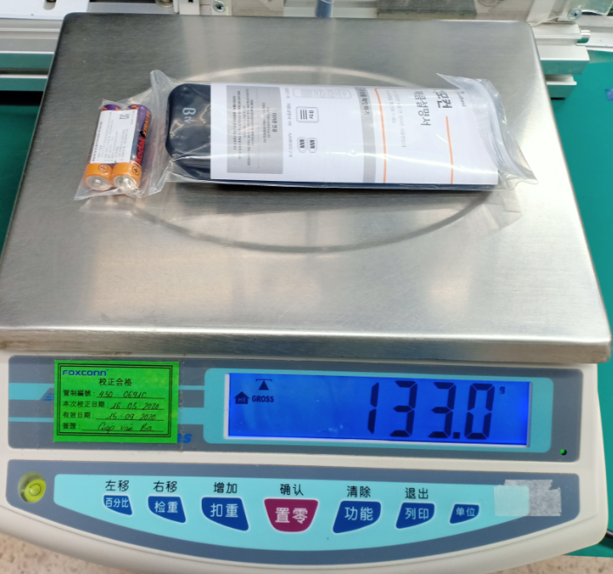
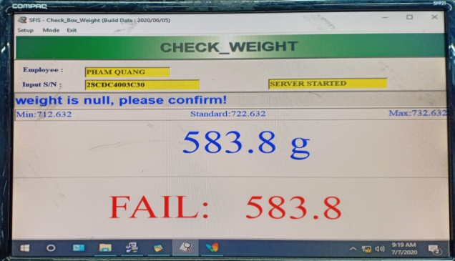
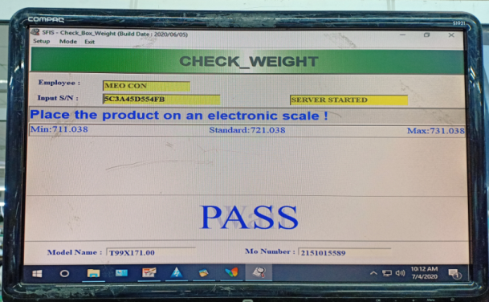
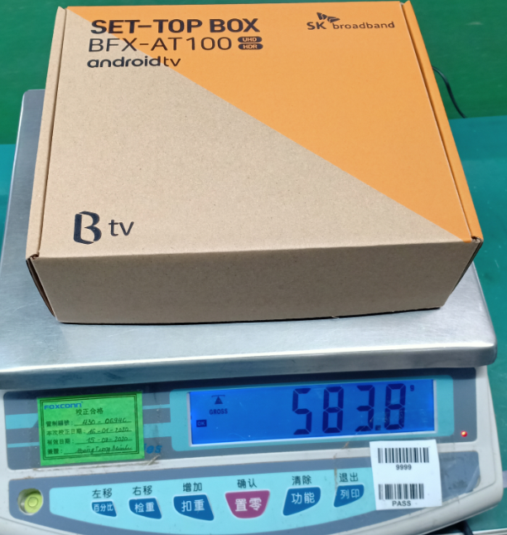
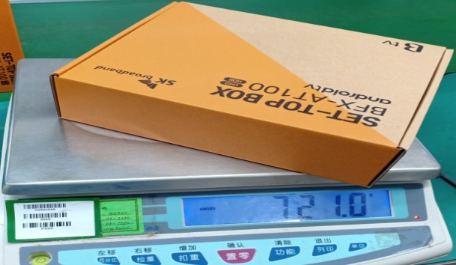
D4. Identify the Root Cause (continue)
Appendix: Please Refer to below pictures for “check weight” station preventing missing RCUs online.
RCU weight
Missing RCU weight
Normal Box weight
Conclusion : The root cause has nothing to do with the function of check weight station. Normal process check weight set up online as below values, so check Weight station can cover if don’t put in RCU into Box. The real root cause is stated in previous slide.
1

Slide 13
D4. Identify the Root Cause (continue)
4.2. Inner sheet missing on carton box.
Root cause:
Because this product packing requirement follow SN continue list, in SOP only fix 01 OP. due to many operations, 1 OP can not respond all.
And then add 1 OP to support- total 2 OP at packing CTN station, but they don’t separate its working flow clearly. Maybe he forgot to put the inner sheet on carton box
Occur cause: Pack CTN new operator in B06 production line was also performed by himself, he did not check carefully lead to defect escaped.
Conclusion: Pack CTN operator did not check carefully lead to defect escaped.
1

Slide 14
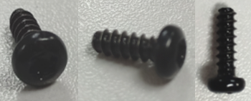
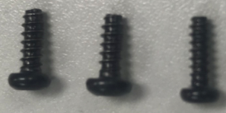
D4. Identify the Root Cause (continue)
4.3 Gift box FOD (Foreign Object Debris).
Root cause:
Check online this screw did not belong to T99X171.00 and all other products kind in factory on production line packing area.
This issue on monitor online product.
Conclusion: Factory keep monitoring the root cause during production to find out where come from that screw.
Some screw picture which use in Factory, but has not found kind of undefined screw was packed gift packing
1

Slide 15
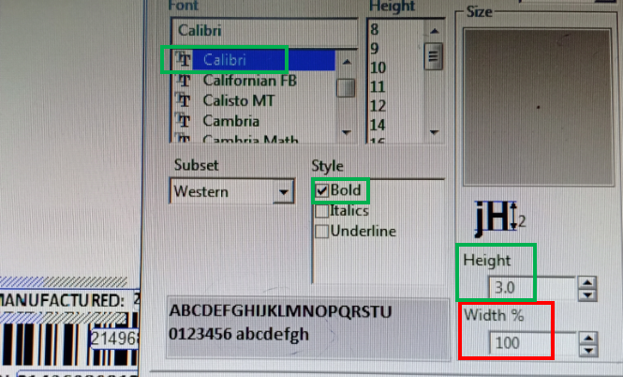
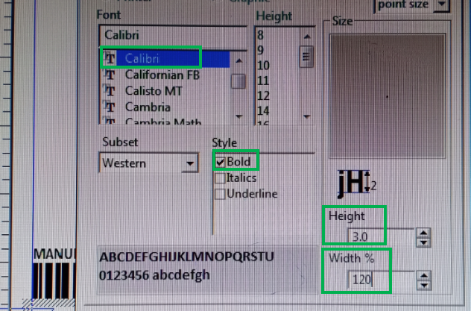
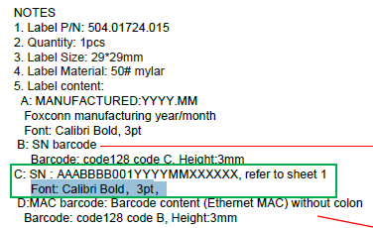
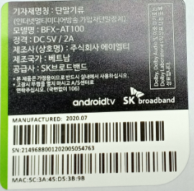
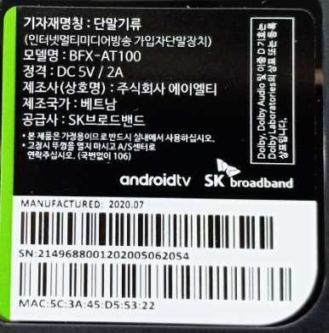
D4. Identify the Root Cause (continue)
4.4. Label Font change
Root cause:
All Font and barcode spec we set up label print program follow customer request, no any change spec.
Check Customer feedback problem is related to text Width%. At factory we set-up normally With% =100% but compare with customer feedback golden sample have a bit short, check with old printing program (B04 factory), manually set-up With% = 120%.
PMD defined Label print setup
Conclusion: According to program set up pictures, we are no change any font or spec of label, all set up follow customer approved and PMD defined. But do not manual change set-up With% = 120%, which cause text data face a bit short v.s golden sample
1

Slide 16
D4. Identify the Root Cause (continue)
4.5. Giftbox contamination
The oil on Box and shoe footprint :
Occur cause: This is material incoming issue, vendor have improved this issue.
Escape cause: At Pack Box station OP didn’t check this issue because SOP didn’t request check Box visual, so lead to these NG box escape to customer.
1

Slide 17
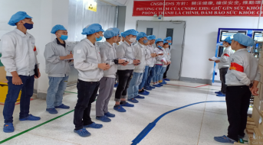
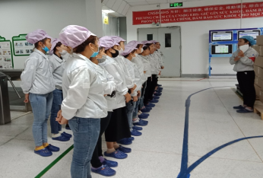
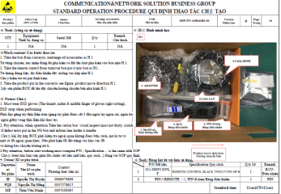
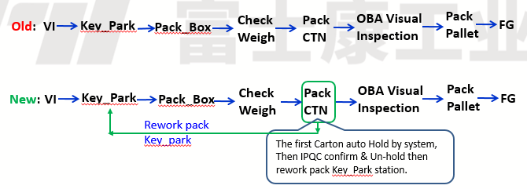
D5. Corrective Action
5.1 RCU missing issue :
Short term action:
5.1.1. Alarm and remind line leader and all operators at production line do not by pass any accessory in any case. Training Line leader and OP doing follow process and SOP.
Owner: PD: Wen Yong Due date: 02 Jul 2020 →Done
5.1.2. Update NG picture to Arrange accessory SOP for OP check and notice each begin shift.
Owner: PD: Wen Yong Due date: 03 Jul 2020 →Done
Long term action:
5.1.3. Apply control the first Carton of the first Pre-MP/Control run will auto HOLD at Pack_PLT. IPQC will confirm before un-hold this carton. After un-hold this carton will auto rework back Key_park station then follow normal process
Owner: PD/PQE: Wen Yong, Heng Ruan Due date: 27 Jul 2020
Item | Training recorded
1
2
3
1

Slide 18

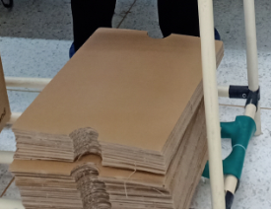
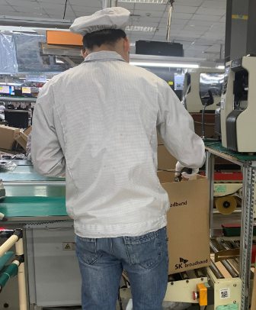
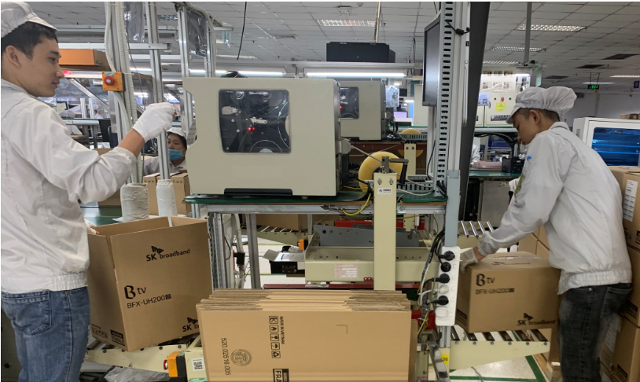
D5. Corrective Action (continue)
5.2. Inner sheet missing on carton box issue
5.2.1. Action: In SOP – fixed 2 OP at this station and separated the operation for each person clearly.
Owner: IE: Van Quyen Done: 03 Jul 2020
5.2.2. For 01 pallet have 32 cartons, So PD will take 64 pcs inner sheet put in the waiting rack one time for doing 01 pallet done ( cause 01 carton used 2 inner sheet ), then will take other 64 pcs inner sheet to make next pallet.
Owner: PD: Wen Yong, Done: 03 Jul 2020
Before Improved | After Improved
SOP Fix 01 OP at Box weight & pack Pallet station. | SOP Fix 02 OP at Box weight & pack Pallet station.
64 pcs Inner sheet separate online in waiting rack
Box weight & Pack Pallet station
1

Slide 19

D5. Corrective Action (continue)
5.3. Label Font change issue
5.3.1. Building new printer label follow new request then doing FAI label online follow new spec customer inform.
Owner: PE/PD/PQE: Hue Ruan, Wen Yong, Heng Ruan Done: 2 Jul 2020
5.3.2. Line leader & IPQC remind and alarm daily check online product.
Owner: PE/PD/PQE: Hue Ruan, Wen Yong, Heng Ruan Done: 2 Jul 2020
PMD defined Label print setup
Label print setup
Label FAI
1

Slide 20

D5. Corrective Action (continue)
5.4. Giftbox contamination issue
5.4.1. Add NG picture to SOP at Pack Box station, remind all OP to know and reject any Box material cosmetic issue.
Owner: IE: Van Quyen Done: 3 Jul 2020
5.4.2. Showed and reminded all operators to pay attention to their operating and follow SOP. Operator at pack box and pack carton station need fold giftbox more carefully and recheck cushion sheet before packing carton to avoid missing.
Owner: PD : Wen Yong, Done: 3 Jul 2020.
1

Slide 21

D6. Verification of effectiveness
6.1. Quality alert and SOP were updated in inspection requirement already and hang on production line, IPQC keep audit and verifying the implementation on production line.
6.2. Operators were reminded and trained to know this issue for more pay attention to their job, compulsory follow standard operation procedure as SOP defined.
1

Slide 22
D7. Prevent recurrence
7.1. Line leader remind all operators before production meeting and monitor their operating daily.
Owner: PD: Wen Yong Done : 3 Jul 2020
7.2. Daily IPQC will random sample check after VI and pack box station to recheck product and package status.
Owner: PQE: Heng Ruan Done: 3 Jul 2020
1

